Slide 1
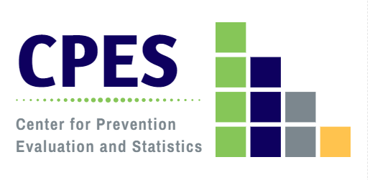
2020 Connecticut Community Readiness Survey Results: CONNECTICUT
A presentation to the
DMHAS Resource Links
Wednesday, December 2, 2020, 10 am
Microsoft Teams
Jennifer Sussman
DMHAS Center for Prevention Evaluation and Statistics (CPES)
at UConn Health

Slide 2
What is the Community Readiness Survey (CRS)?
A biennial key informant survey, conducted since 2006, to assess community-level attitudes, capacity, and readiness to implement prevention/health promotion activities relevant to behavioral health;
A joint collaboration between the DMHAS, the RBHAOs, the University of Connecticut Department of Public Health Sciences, and the Connecticut Clearinghouse;
Key informants were identified regionally by the RBHAOs, with personalized outreach conducted by RBHAOs and DMHAS prevention partners;
Results at the state and regional levels are used to inform planning, leverage resources, and inform ongoing prevention efforts.

Slide 3
Community Readiness Survey (CRS) Objectives
Measure community capacity and readiness for substance misuse prevention and mental health promotion:
Community attitudes about alcohol and drug use, mental health issues, suicide and problem gambling;
Community support for prevention and health promotion;
Perceived barriers to substance abuse prevention and mental health promotion;
Ratings of community readiness;
Develop a tool and methodology to respond to DMHAS’ ongoing needs for needs assessment, evaluation; and impact assessment;
Inform planning at state and regional levels;
Identify needs for training and technical assistance.

Slide 4
The 2020 CRS
In response to DMHAS’ integration of mental health and substance misuse initiatives, the CRS 2020 was re-tooled:
The survey was expanded to more fully assess mental health, suicide and gambling attitudes, concerns and readiness;
Items were omitted/consolidated to improve accessibility and reduce survey fatigue;
Included parallel questions assessing mental health attitudes, concerns, and capacity;
Added a 9-point mental health promotion readiness scale;
Added items on problem gambling/gaming/sports betting;
Content changes were informed by a workgroup comprised of: RBHAOs, community prevention partners, and knowledgeable staff from DMHAS, UConn Health/CPES, and the CT Clearinghouse;
Revision of the survey was a data-driven process, informed by item analyses, reliability and validity assessment, and scale testing.
Reports Available
by State, RBHAO, and Community Type
(The Five Connecticuts)

Slide 5
Community Type: The Five Connecticuts
The Five Connecticuts are a rubric developed in 2004 by the Connecticut State Data Center as a means of disaggregating Connecticut’s 2000 census data in a meaningful way.
Five Connecticuts designations are based on criteria of each town’s:
median household income;
population density; and
poverty rate
Five Connecticut community types:
Wealthy
Suburban
Urban Periphery
Urban Core
Rural
These categories were updated in 2014 using the 2010 census data by the original developer of the designation. The updated designations have been used to categorize data for the Community Wellbeing Surveys since 2015 and the 2018 and 2020 Community Readiness Survey, and are used by others as well.
Levy, Don and DataHaven. (2015): Five Connecticuts 2010 Update. Produced for Siena College Research Institute and DataHaven based on the original method of assigning designations used in Levy, Don, Orlando Rodriguez, and Wayne Villemez. 2004. The Changing Demographics of Connecticut - 1990 to 2000. Part 2: The Five Connecticuts. Storrs, Connecticut: University of Connecticut SDC Series, no. OP 2004-01.

Slide 6
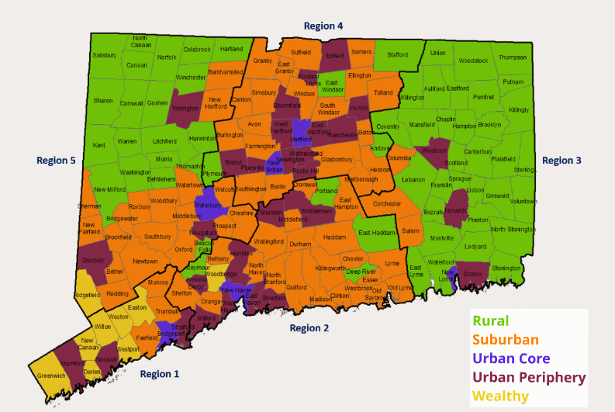
Community Types in Connecticut: The Five Connecticuts (5CT)
CPES, 2019

Slide 7
Community Readiness Survey Response Rates over Time
Success!
 | 2006 | 2008 | 2010 | 2012 | 2014 | 2016 | 2018 | 2020
Respondent N | 433 | 479 | 774 | 838 | 746 | 799 | 1019 | 1236
Target N | 639 | 908 | 1222 | 1442 | 1728 | 1455 | 1932 | 2071
Response Rate | 68% | 53% | 63% | 58% | 43% | 55% | 53% | 60%
Representation in 166 (98%)
of 169 Connecticut communities
Response goals met in 117 (69%) communities statewide:
91 with population < 40,000 (63.6%)
26 with population 40,000+ (100%)

Slide 8
Key Informant Demographic Characteristics: Connecticut CRS, 2020
n=1,236
Age
Gender
Race
Notes:
Unweighted percents

Slide 9
Key Informant Stakeholder Affiliation: Connecticut CRS, 2020
* Personal or family experience with mental illness, substance misuse, or problem gambling
** Includes: advocate, community member, municipality, philanthropic organization, non-profit, business
Notes:
Unweighted percents

Slide 10
Problem Substances of Greatest Concern According to Key Informants By Age Group: Connecticut CRS, 2020
Notes:
Weighted percents

Slide 11
Community Attitudes Toward Substance Misuse Prevention: Connecticut CRS, 2020
Key Informant believes that most community residents ….
Notes:
Weighted means

Slide 12
Community Attitudes Toward Substance Use: Connecticut CRS, 2020
Key Informant believes that most community residents ….
Notes:
Weighted means

Slide 13
Community Attitudes Toward Gambling and Gaming: Connecticut CRS, 2020
Key Informant believes that most community residents ….
Notes:
Weighted means

Slide 14
How important is it to prevent problem gambling/gaming addiction in your community?
How would you rate your community’s ability to raise awareness about the risks of problem gambling/gaming addiction?
Notes:
Weighted percents

Slide 15
Mental Health Issue of Greatest Concern According to Key Informants By Age Group: Connecticut CRS, 2020
Notes:
Weighted percents

Slide 16
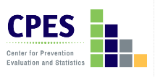
Mental Health Issue of Greatest Concern for Youth and Young Adults, by Community Type, According to Key Informants: Connecticut CRS, 2020
12-17
Notes:
Weighted percents

Slide 17
Community Attitudes Toward Mental Health: Connecticut CRS, 2020
Key Informant believes that most community residents ….
Notes:
Weighted means

Slide 18
Community Support for Suicide Prevention Efforts: Connecticut CRS, 2020
Notes:
TEST: Kruskal-Wallis/Mann – Whitney U (to detect differences between groups)

Slide 19
Community Ability to Implement Suicide Prevention Efforts: Connecticut CRS, 2020
Notes:
TEST: Kruskal-Wallis/Mann – Whitney U (to detect differences between groups)

Slide 20
Suicide Prevention Supports in Place in the Community: Connecticut CRS, 2020
Key Informant believes that the following are in place in the community….
Notes:
Weighted means

Slide 21
Community Readiness to Undertake Behavioral Health Promotion Activities*: Connecticut CRS, 2020
Key Informant believes that the community is ready to….
*Behavioral Health Promotion Activities includes substance misuse prevention and mental health promotion activities.
Notes:
Weighted means

Slide 22
Key Informant Ratings of the Community Stage of Readiness for Substance Misuse Prevention: Connecticut CRS, 2020
Community Stage of Readiness for Substance Misuse Prevention: Connecticut (n=889) | Percent
1 - This town/city tolerates or encourages substance misuse. | .9
2 - This town/city has little or no recognition of the substance misuse problem. | 3.5
3 - This town/city believes that there is a substance misuse problem, but awareness of the issue is only linked to one or two incidents involving substance misuse. | 9.1
4 - This town/city recognizes the substance misuse problem and leaders on the issue are identifiable, but little planning has been done to address problems and risk factors. | 24.6
5 - This town/city is planning for substance misuse prevention and focuses on practical details, including seeking funds for prevention efforts. | 23.6
6 - This town/city has enough information to justify a substance misuse prevention program and there is great enthusiasm for the initiative as it begins. | 7.8
7 - This town/city has created policies and/or more than one substance misuse prevention program is running with financial support and trained staff. | 12.5
8 - This town/city views standard substance misuse programs as valuable, new programs are being developed to reach out to at-risk populations and there is ongoing sophisticated evaluation of current efforts. | 10.8
9 - This town/city has detailed and sophisticated knowledge of prevalence, risk factors, and substance misuse program effectiveness and the programming is tailored by trained staff to address risk factors within the community. | 7.3
Mean Stage of Readiness for Connecticut | 5.37

Slide 23
Key Informant Ratings of the Community Stage of Readiness for Mental Health Promotion: Connecticut CRS, 2020
Community Stage of Readiness for Mental Health Promotion: Connecticut (n=895) | Percent
1 - This town/city is unsupportive of those with mental health issues. | .9
2 - This town/city has little or no recognition of the community’s concern about mental health. | 5.7
3 - This town/city believes that mental health concerns impact the community, but awareness of the issue is only linked to one or two situations involving mental health. | 13.4
4 - This town/city recognizes the mental health concerns of the community and leaders on the issue are identifiable, but little planning has been done to address problems and risk factors. | 31.8
5 - This town/city is planning for mental health promotion programs and focuses on practical details, including seeking funds for awareness efforts. | 19.8
6 - This town/city has enough information to justify a mental health promotion program and there is great enthusiasm for the initiative as it begins. | 7.0
7 - This town/city has created policies and/or more than one mental health promotion program is running with financial support and trained staff. | 7.8
8 - This town/city views standard mental health promotion programs as valuable, new programs are being developed to reach out to at-risk populations and there is ongoing sophisticated evaluation of current efforts. | 8.9
9 - This town/city has detailed and sophisticated knowledge of prevalence, risk factors, and mental health promotion program effectiveness and the programming is tailored by trained staff to address risk factors within the community. | 4.6
Mean Stage of Readiness for Connecticut | 4.88
Visit the SEOW Prevention Data Portal: https://preventionportal.ctdata.org/

